Slide 1
CGB1201 – JAVA PROGRAMMING
Department of Artificial Intelligence and Data Science
Academic Year: 2024 – 2025 (Odd Semester)
Register Number : 2303811724322104
Name : SHEKKINAH HEPHZIBAH M
Year : II
Semester : III
Section : B
Date : 03.12.2024

Slide 2
Title of the Project
BUDGET CALCULATOR

Slide 3
Problem Identification
Ensure that the user input for income and expenses is validated correctly to prevent errors in the calculation
Design an efficient system for categorizing income and expenses accurately.
Provide the functionalities for managing transactions efficiently including adding, editing, and deleting transactions

Slide 4
Objective
Design an application to accept the user input for income and expenses.
Implement the necessary calculations to determine the user’s total income, expenses and savings.
Include a feature for displaying the summary and helps to calculate monthly and yearly financial data to compare the income and expenses.

Slide 5

Proposed Architecture
USER
INPUT
API REQUEST
BUSINESS LOGIC
BUDGET UPDATE
RESPONSE
VIEW SUMMARY

Slide 6
Java Programming - Concepts Used
Object-Oriented Programming (OOP):
OOP’s principles like classes, objects, inheritance, and encapsulation
to structure the program efficiently.
Exception Handling:
This ensures the program remains robust by catching and handling.
errors (e.g., incorrect input or invalid data)
Arrays/Lists:
To store user data such as expenses and categories.
Input/Output (I/O):
For user interaction and saving/loading the data.

Slide 7
List of Modules
Transaction Management Module
Category Management Module
Data Summarization Module
Report Module

Slide 8
Module Description
Transaction Management Module:
Add new income or expense transactions with details such as date, category, and amount.
Edit existing transactions for corrections.
Delete transactions to remove incorrect or unwanted entries.
2.Category Management Module:
Allows categorization of income and expenses (e.g., salary, utilities, groceries)
Assigns the categories to transactions.

Slide 9
Module Description (Cont..)
Data Summarization Module:
Filters and calculates totals for monthly and yearly income and expenses.
Provides monthly and yearly summaries
Report Module:
Generates reports showing trends in income and expenses.
Views the total summary of the budget.

Slide 10
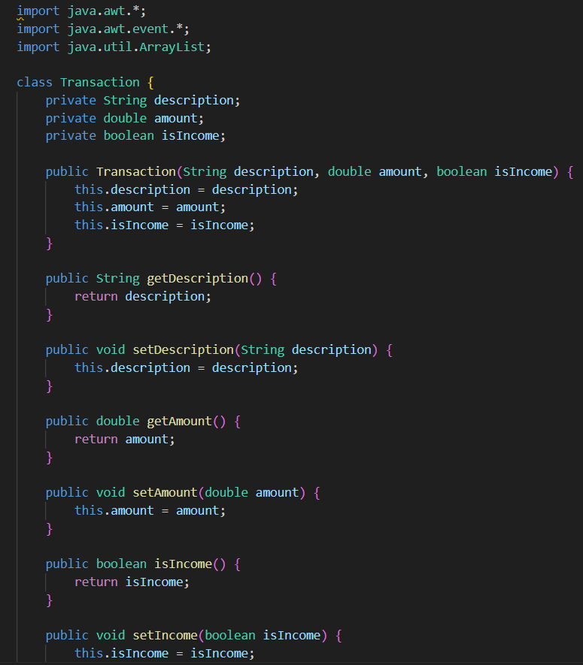
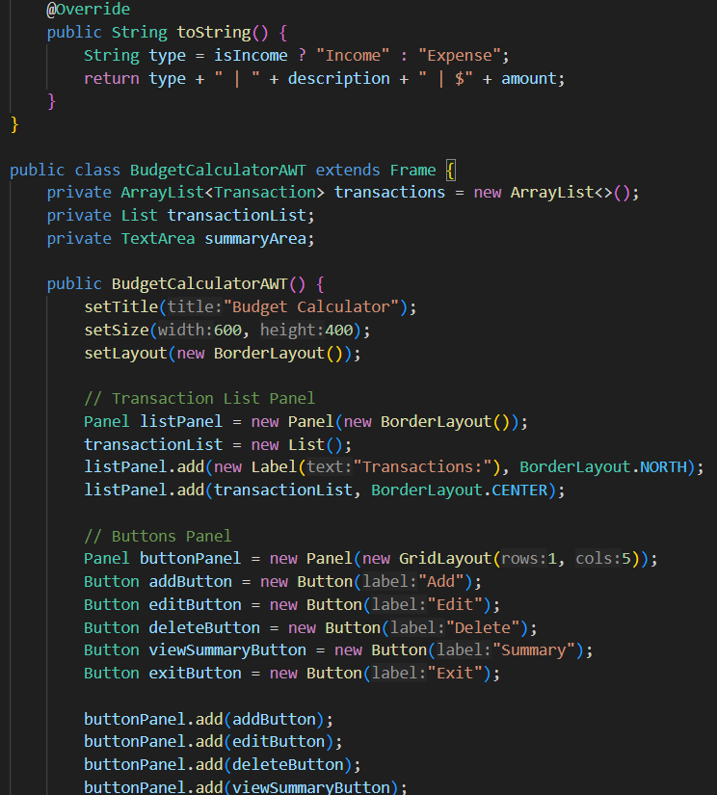
Source Code

Slide 11
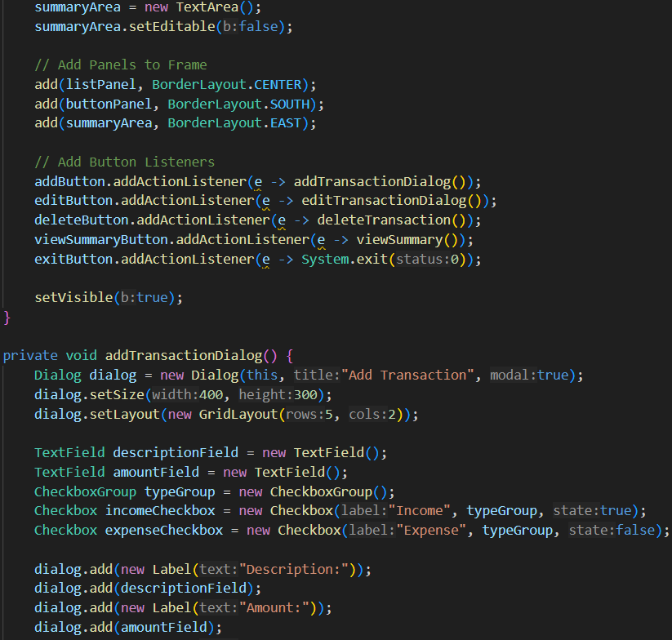
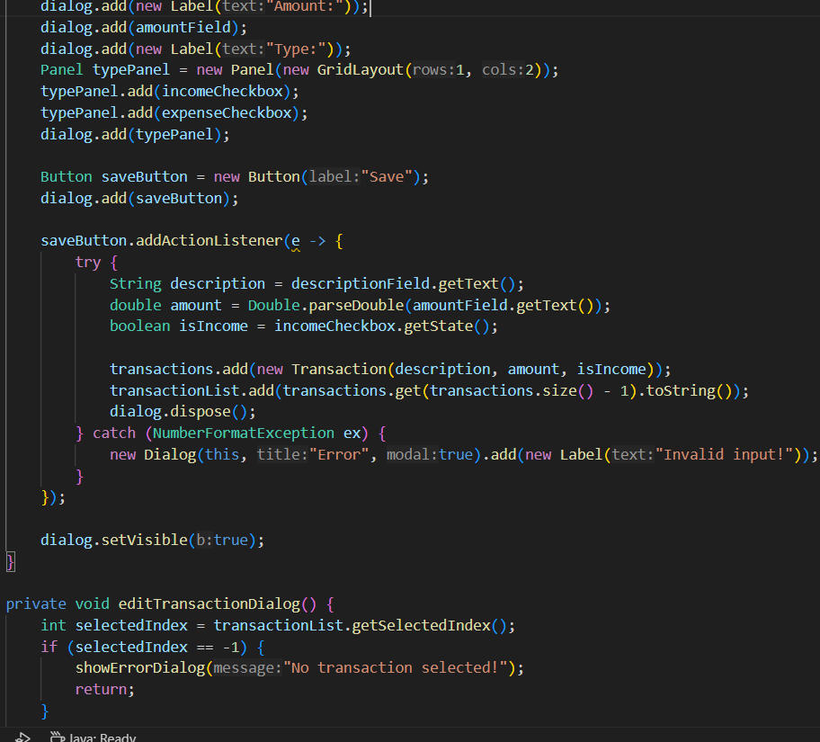
Source Code

Slide 12
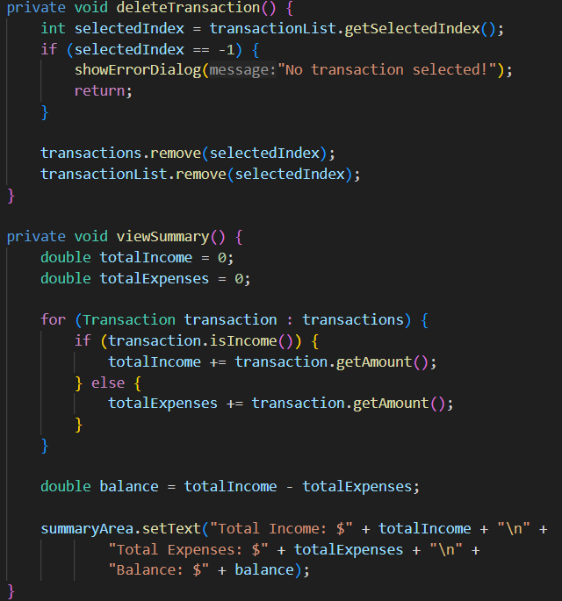
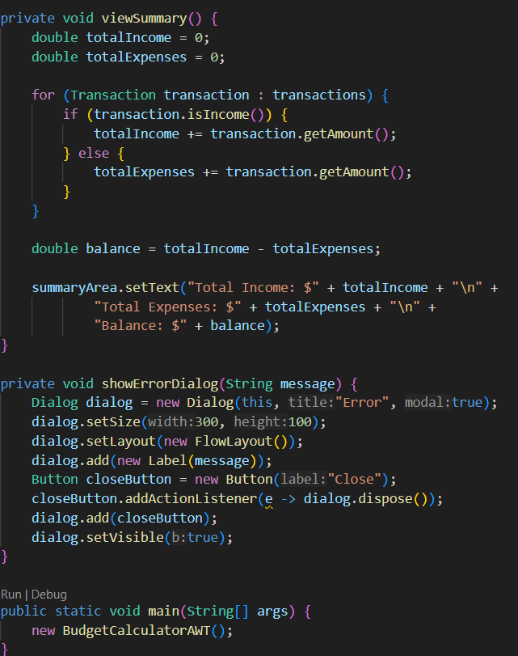
Source Code

Slide 13
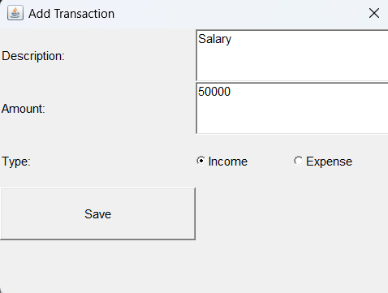
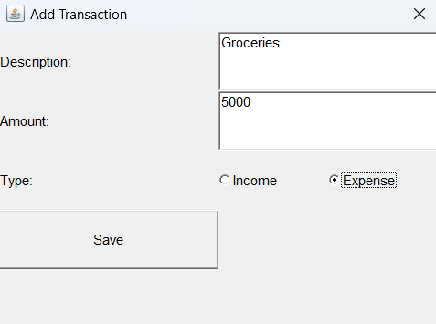
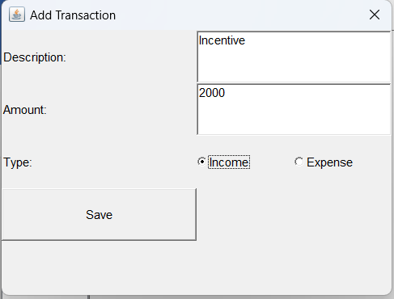
Results
ADD TRANSACTION

Slide 14
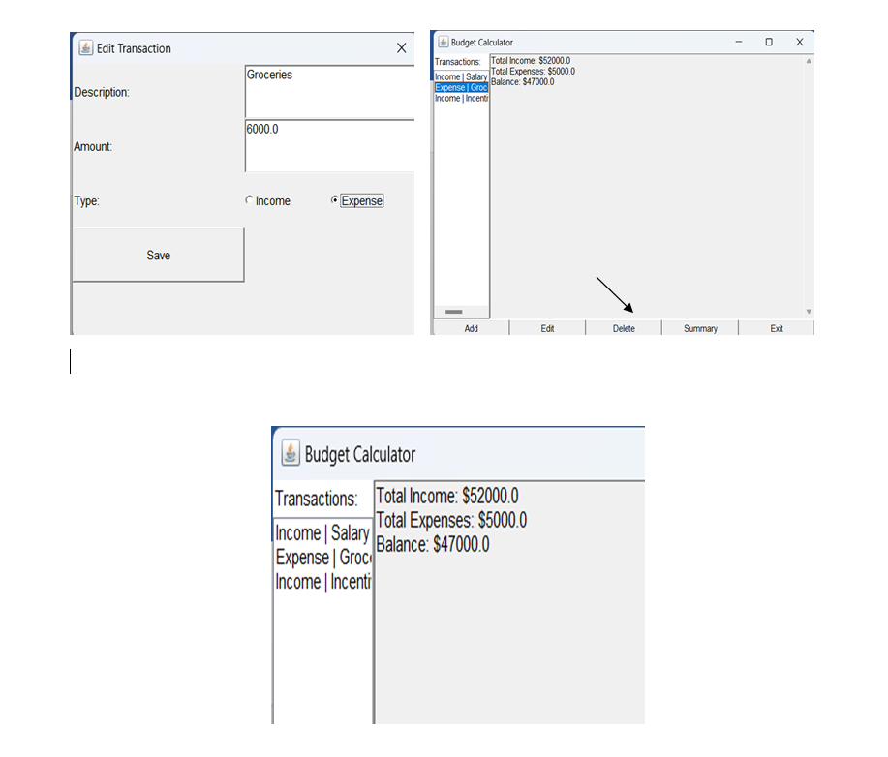
Results
EDIT TRANSACTION DELETE TRANSACTION VIEW SUMMARY

Slide 15
Conclusion
The Budget Calculator application provides an efficient and user-friendly solution for personal finance management.
It allows users to add, categorize, and manage their income and expenses, generate monthly and yearly summaries, and visualize their financial data.
This project highlights the importance of leveraging technology to promote better financial habits and planning.

Slide 16
Thank You
Any queries???

